Slide 1
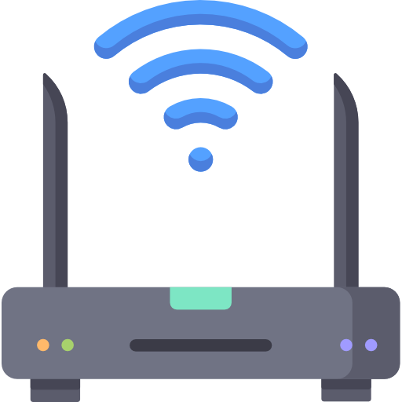

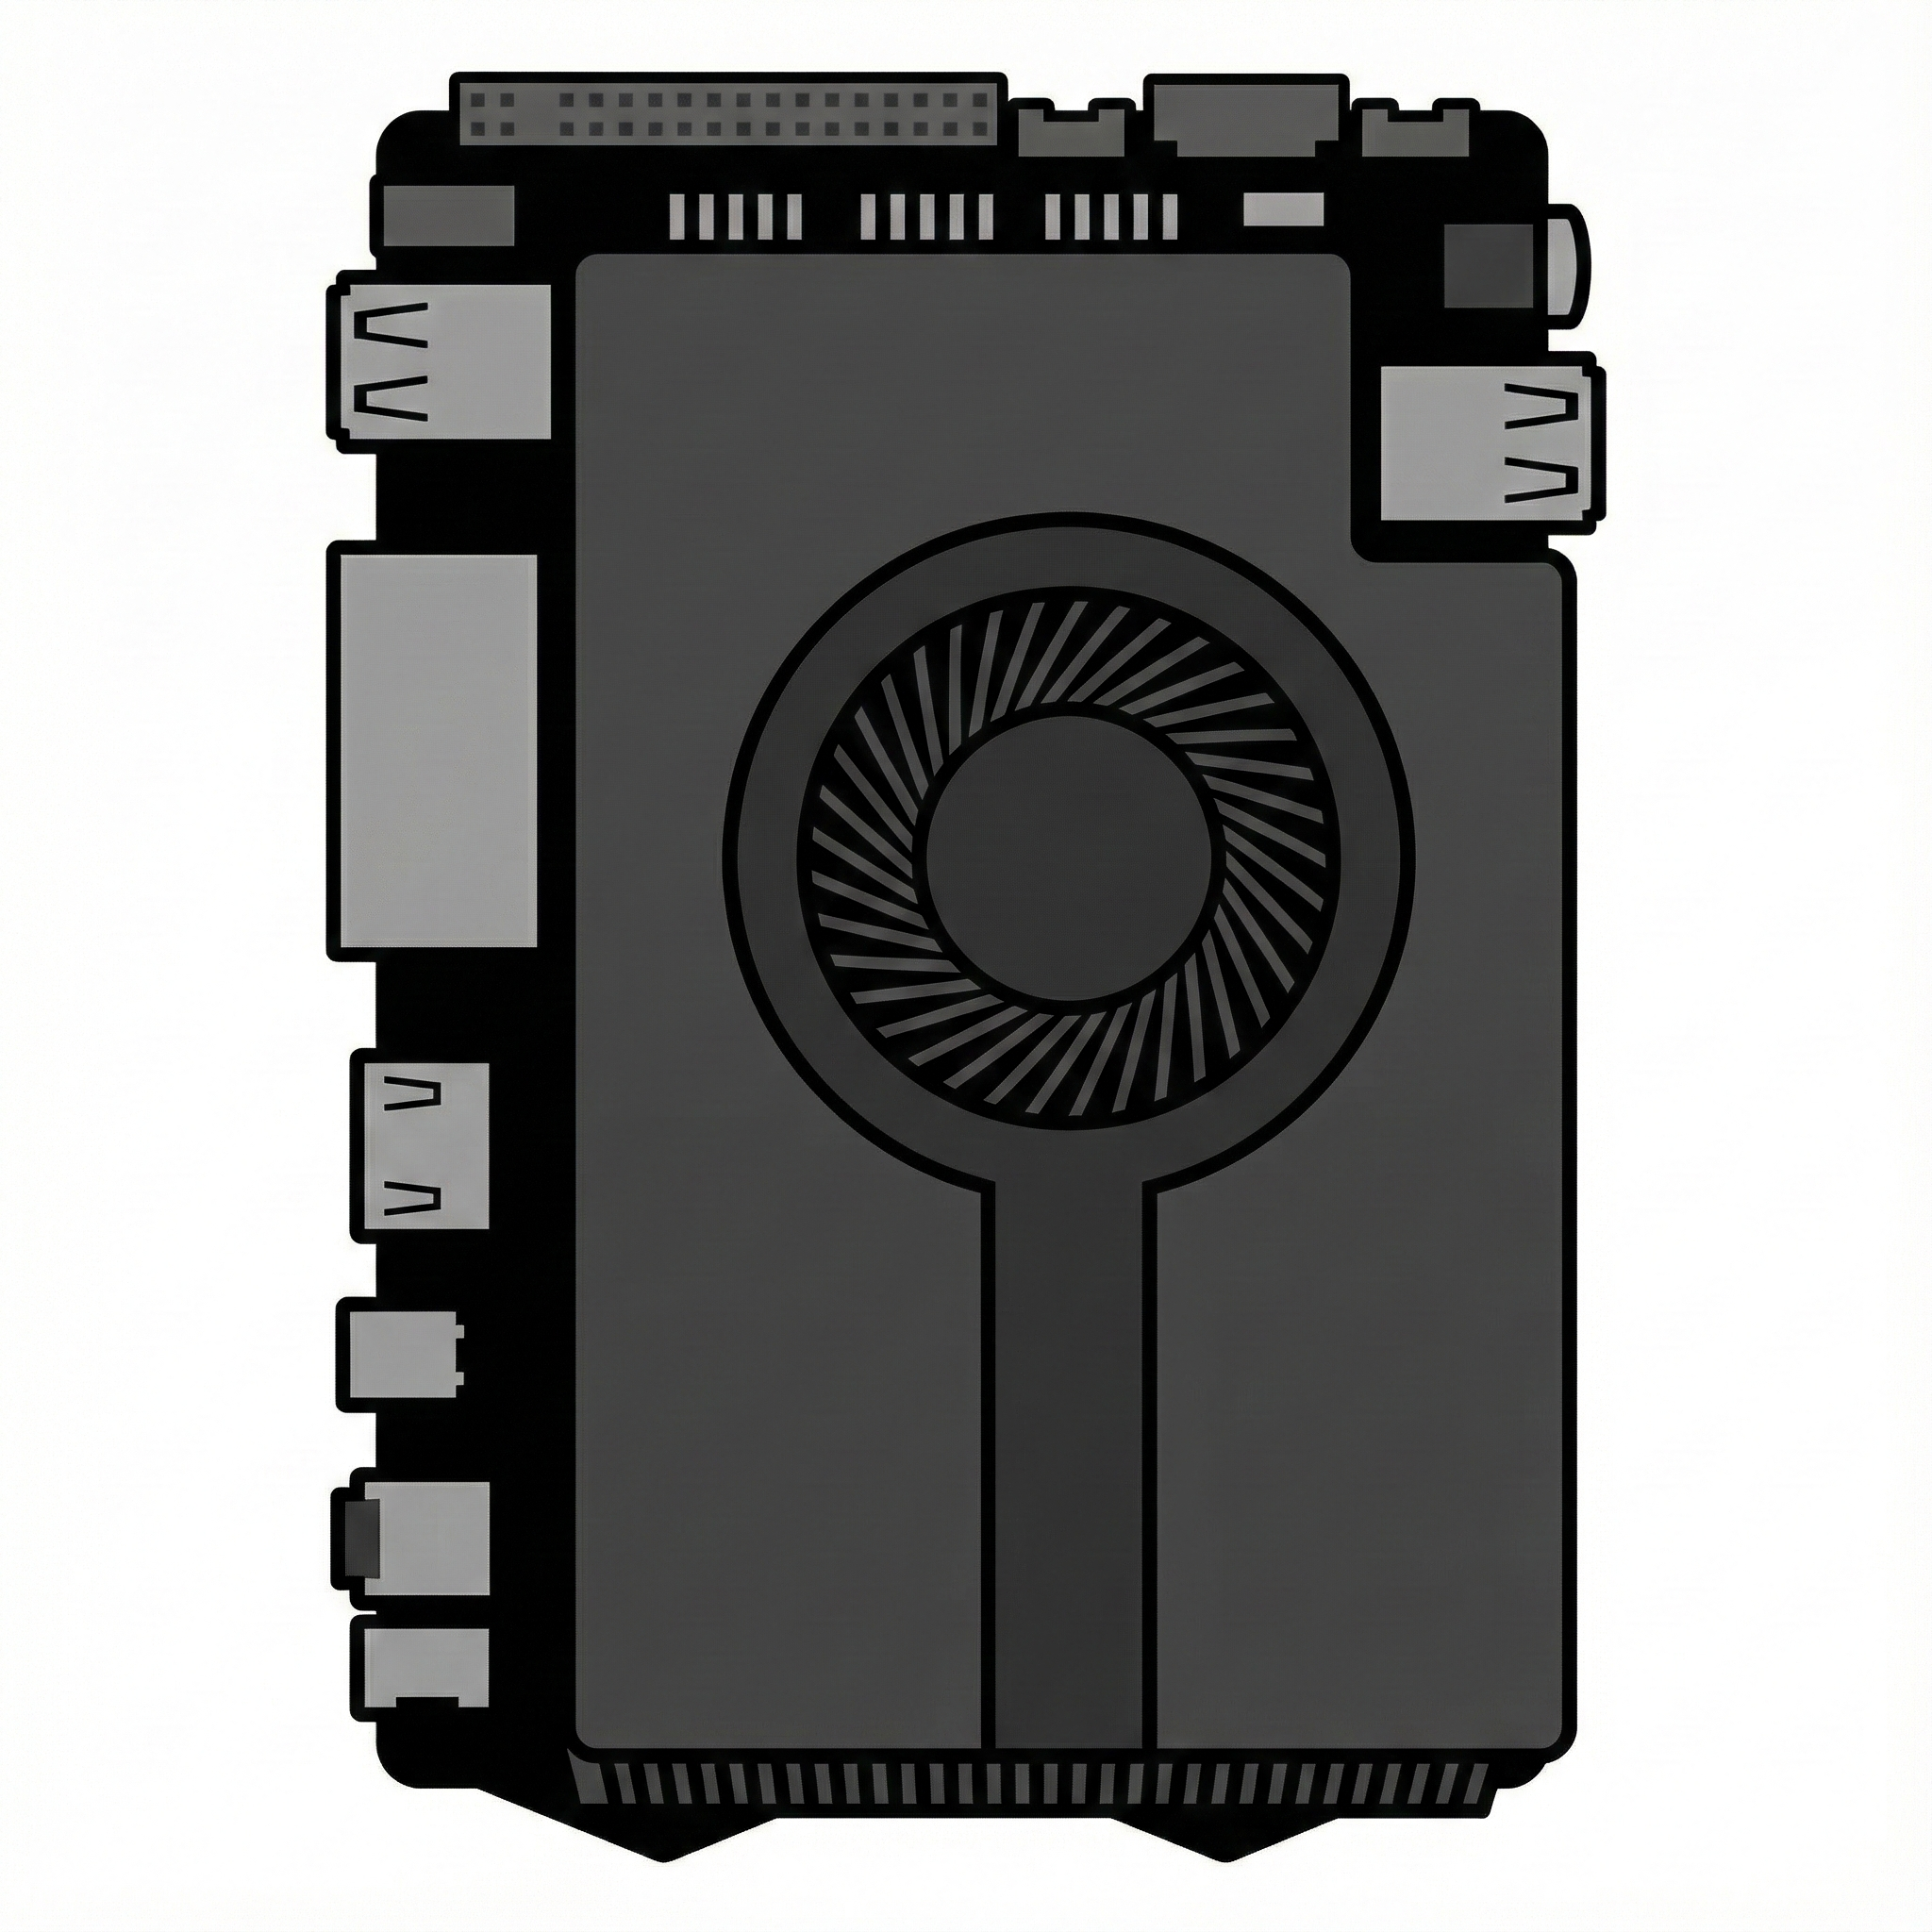



Wired
Wireless
UDP
TCP
Access Point
(192.168.0.1)
Control Commands
Status Reports
Racing Wheel
Controller
(192.168.0.2)
G-Wagen
(192.168.0.3)
Video Stream

